Slide 1
CS776 Project by Team: God's Eye DoodleVision: Transforming Hand-Drawn Sketches into Digital Reality
Member Name | Roll Number
Aryan Agarwal | 241110012
Keshav Banka | 241110032
Himalaya Kaushik | 241110029
Yuvraj Raghuvanshi | 241110084
Tsewang Namgail | 241110093
Tsewang Chukey | 241110092

Slide 2
Outline of Presentation
Problem Statement and Project Brief
Potential Approaches
Literature Review
Industry Use Cases
Progress Status, Project Deliverables and Timeline
Team Contributions

Slide 3
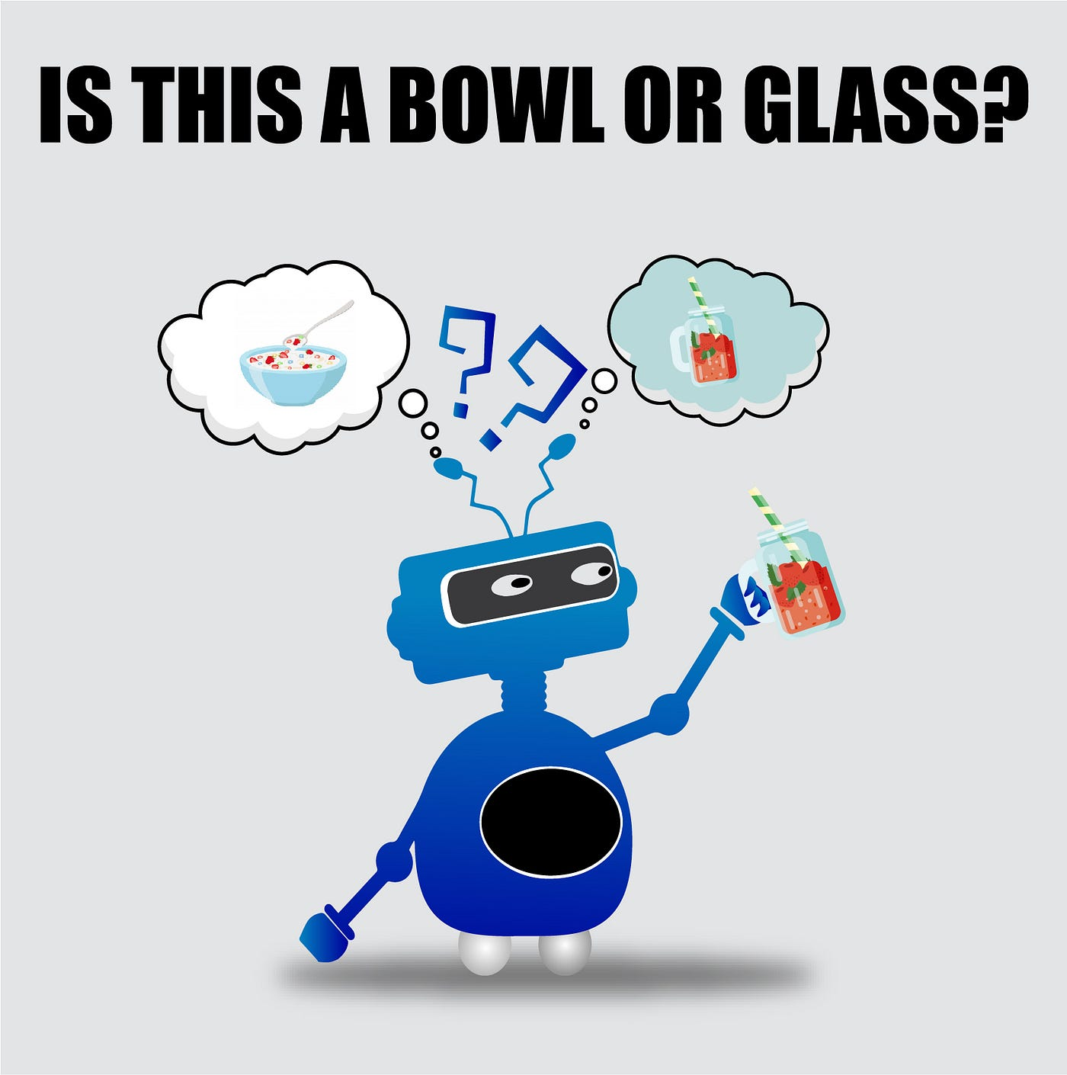
Problem Statement and Project Brief
Problem Statement: Build a Real-time Object Identification Model for hand-drawn sketches and improve its prediction accuracy and speed of prediction
Project Brief:
Our project involves developing an interactive user interface where users can draw objects by hand in real-time.
As the user draws, a deep learning model predicts what object is being sketched. The model processes the strokes dynamically, updating predictions as the drawing evolves.
By optimizing both the accuracy and speed of the prediction using techniques like transformers and SSD-based models
Img src: https://www.shutterstock.com/search/arm-bowl?image_type=illustration&page=3

Slide 4
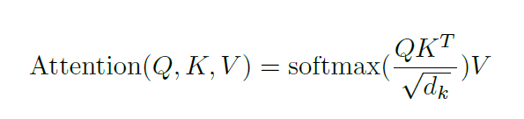
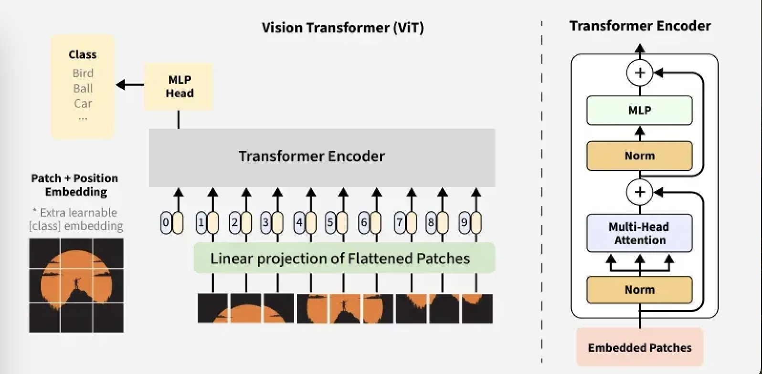
Transformer-Based Models in Image Detection:
In transformers for image detection (such as ViT), images are split into patches x_i , each represented as a vector. These vectors are passed through a self-attention mechanism, which computes how each patch relates to the others:
Where:
Q(queries), K(keys), and V (values) are linear projections of the input vectors.
D_k is the dimension of the key vectors.
The model uses these weights to capture the most important regions of the image.
Potential Approaches
Img src: https://www.geeksforgeeks.org/vision-transformer-in-computer-vision/

Slide 5
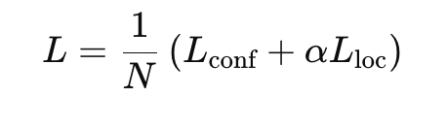
ConvLSTM:
-An extension of LSTM designed for spatial data. -Its key equations are similar to LSTM but replace matrix multiplications with convolutions. -It also captures both spatial and temporal patterns in sequential image data, which is beneficial for recognizing evolving sketches. Single-Shot Detector (SSD):
-SSD detects objects in an image by predicting bounding boxes and class labels for each grid cell of the image. The loss function consists of a localization loss and a confidence loss: where Lconf is the softmax loss, Lloc is the Smooth L1 loss for bbox regression. α is a balancing factor, and N is the number of matched default boxes.
-Incorporating attention mechanisms from transformers can improve SSD by focusing on relevant regions of the image, enhancing the detection of doodles.
YOLO (You Only Look Once):
-It treats object detection as a single regression problem. -The image is divided into an S×S grid, and each grid cell predicts bounding boxes and class probabilities. -By incorporating transformers, YOLO can leverage attention to focus on key features in the image for more accurate detection of drawn objects.
Potential Approaches (contd.)

Slide 6
Dataset details: Google Creative Lab Dataset is used which is a collection of 50 million drawings across 345 categories. The drawings were captured as timestamped vectors and tagged with metadata including what the object to be drawn is.
UI implementations: We will build an interface where user can draw an object on screen using mouse pointer, and upon finishing the sketch/doodle the model will predict what object it is from the set of known classes it has.
Img src: https://github.com/googlecreativelab/-dataset?tab=readme-ov-file

Slide 7
Literature Review and Related Work
Paper Title & Authors | Journal/Conference | Publish year | Issue it addresses/Learnings | Limitations identified & Improvements we suggest to add in our work
Deep learning assisted real-time object recognition and depth estimation for enhancing emergency response in adaptive environment By Faseeh Et al. | Results in Engineering 24 (2024) 103482 | 2024 | Improves precision and response times for real-time applications using ConvLSTM and attention mechanisms, solving challenges of depth estimation over distances. | Struggles with computational efficiency when expanding to highly complex scenarios, especially with moving objects over long ranges. Suggestion: Utilize the Temporal Stroke Analysis for the limited range of motion we have in our project along with efficient attention mechanisms.
Design and implementation of real-time object detection system based on single-shoot detector and OpenCV By Wahab Et al. | Frontiers in Psychology, 13 | 2022 | Proposes a real-time object detection system using the SSD algorithm and pre-trained models, achieving high-speed detection in various environments. | While effective for real-time object detection, the system might underperform when handling hand-drawn or irregular objects. Improvement: Utilize a transformer-based model to handle the complex/irregular objects
SketchFormer: transformer-based approach for sketch recognition using vector images By Parihar Et al. | Multimedia Tools and Applications 80(11) | 2021 | Proposes a transformer-based model for sketch recognition, utilizing attention mechanisms to identify and classify sketches as sequences of strokes. | Computational complexity in real-time applications due to the transformer’s large model size. Improvements: We can try different variants of attention mechanism (bottleneck) to improve speed

Slide 8
Literature Review and Related Work
Paper Title & Authors | Journal/Conference | Publish year | Issue it addresses/Learnings | Limitations identified & Improvements we suggest to add in our work
Real-time object detection (YOLOv5) (Yuxin Zhao, Shaodong Wang) | Highlights in Science, Engineering & Technology AIEA | 2022 | - Addresses real-time detection of contraband in public areas using YOLOv5. - Learnt adaptive anchor calculation, improved detection accuracy (84.7%) and speed. | - Dataset size is limited (4000 images). → Improvements: Expand the dataset, include diverse object classes, and test robustness in varied environmental conditions.
Improved real-time object detection method based on YOLOv8: a refined approach (Jiaqi Zhong, Huaming Qian, et al.) | Journal of Real-Time Image Processing | 2025 | - Enhances YOLOv8 with novel Faster-C2f (Cross-Stage Partial Connections with Bottleneck Focus) backbone, Sim-SPPF (Spatial Pyramid Pooling – Fast), and improved PANet & CCFPANet (Cross-scale Channel Fusion PANet) neck structures. - Reduces parameters (up to 54.5%) while maintaining high detection accuracy and speed (108 FPS). | - Computational complexity still a factor despite reduction in parameters. → Improvements: Further reduce computational complexity, optimize the model for diverse object types, explore attention mechanisms more comprehensively
Hand-drawn doodle detection using machine learning (Vijaya Bhaskar Reddy Buchireddy, et al.) | AIP Conference Proceedings | 2025 | - Hand-drawn doodle recognition using CNN with batch normalization, max-pooling layers, Adam optimizer. - Achieved 85% accuracy with systematic preprocessing and augmentation. | - Limited dataset size (250 classes). → Improvements: Utilize larger, diversified datasets, implement transfer learning for enhanced accuracy, optimize for real-time applications.

Slide 9
Literature Review and Related Work
Paper Title & Authors | Journal/Conference | Publish year | Issue it addresses/Learnings | Limitations identified & Improvements we suggest to add in our work
ROMA: Run-Time Object Detection To Maximize Real-Time Accuracy By JunKyu Lee, Blesson Varghese, Hans Vandierendonck | IEEE/CVF Winter Conference on Applications of Computer Vision | 2023 | Selects the best object detector based on the size of objects Maintain real-time performance while maximizing detection accuracy Switching between different object detectors based on input characteristics Balancing accuracy and FPS dynamically | Limitations: Computational Overhead, Not Optimized for Sketches , Object Size Dependency Improvements: Single adaptable CNN Specifically on sketch datasets switch based on stroke complexity (simple sketches → lightweight CNN, detailed sketches → deeper model)
Deep Self-Supervised Representation Learning for Free-Hand Sketch By Peng Xu, Zeyu Song, Qiyue Yin, Yi-Zhe Song, Liang Wang | IEEE/CVF Conference on Computer Vision and Pattern Recognition (CVPR) Workshops | 2020 | Self-supervised learning improves sketch recognition without labeled data. TCNs help model stroke sequences, enhancing dynamic prediction accuracy. Sketch representations generalize well for tasks like retrieval & interactive UI | Limitations: Struggles with Noisy or Incomplete Sketches, Slower Predictions for Fast Sketchers, High Computational Cost Improvements: Add data augmentation ( dropout) and denoising layers. Implement dynamic stroke grouping and attention-based weighting to balance speed and accuracy. Use lightweight convolutions for faster predictions.

Slide 10
Literature Review and Related Work
Paper Title & Authors | Journal/Conference | Publish year | Issue it addresses/Learnings | Limitations identified & Improvements we suggest to add in our work
Interactive System for Toddlers Using Doodle Recognition (Gagandeep, K.N., Belagali, A.R., Rashmi, M., Guddeti, R.M.R.) | Springer Nature Switzerland | 2024 | The paper explores doodle-based HCI for toddlers, using CNNs to enable interaction through drawings, enhancing early learning and accessibility | Challenges include recognition errors and processing speed. Improvements: focus on better datasets, optimized CNN models, faster inference, and AI-driven mood detection
Deep Residual Learning for Image Recognition: A Survey (Shafiq, M.; Gu, Z) | Multidisciplinary Digital Publishing Institute | 2022 | The paper explores ResNet architectures, addressing vanishing gradients, training instability, feature reuse inefficiency, and improving image recognition and deep learning efficiency | Challenges include high computational cost and adversarial sensitivity. Enhancements: focus on optimized architectures, reinforcement learning integration, and memory-efficient designs

Slide 11
Literature Review and Related Work
Paper Title & Authors | Journal/Conference | Publish year | Issue it addresses/Learnings | Limitations identified & Improvements we suggest to add in our work
Meta Analysis of Deep Learning Models for Doodle Recognition (Prateek Sethi, Sachin Duhan, Sanyam Gupta, Goonjan Jain) | 2021 International Conference on Intelligent Technologies (CONIT) | 2021 | -Analyzes deep learning models for doodle recognition. -Evaluates CNNs, ResNet-18, VGG-19, GoogleNet, DenseNet, MobileNet, and SqueezeNet. -transfer learning for reducing training time and better generalization. | Limitations: - Lacks real-time implementation and ignores stroke order information. - Uses a limited dataset (25 classes). Improvements: - Implement real-time stroke processing using RNNs or Transformers. - Expand the dataset with sketch-specific augmentations.
Title: Multigraph Transformer for Free-Hand Sketch Recognition Authors: Peng Xu, Chaitanya K. Joshi, Xavier Bresson | Journal: IEEE Transactions on Neural Networks and Learning Systems Volume: 33, Issue: 10 | 2022 | - proposes a Graph-Based Representation: Converts sketches into multiple sparse graphs to encode both local and global structures. -Introduces a novel multigraph multihead attention (MGMHA) mechanism to process multiple graphs efficiently. -outperforms RNNs, achieves CNN-level accuracy, and offers faster inference, making it suitable for real-time applications. | Limitations: - Designing and optimizing multiple graph structures increases computational complexity. - Evaluates performance primarily using accuracy, lacking additional metrics. Improvements: - Experiment with Graph-Based Representations to enhance recognition. - Incorporate Attention-Based Processing using MGMHA for better feature extraction. - Optimize real-time prediction by integrating MGT with SSD-based models.

Slide 12
Literature Review and Related Work
Paper Title & Authors | Journal/Conference | Publish year | Issue it addresses/Learnings | Limitations identified & Improvements we suggest to add in our work
DoodSearch - OpenCV with Image Recognition (H. Jain, K. Harisinghani, S. Gangar and M. Kambli) | 2022 IEEE Conference | 2022 | Tackling HCI by enabling image search via gesture-based doodling, improving accessibility, enhancing search, and optimizing deep learning for large-scale sketch classification, advancing computer vision and interaction methods. | Facing challenges with complex doodles, and processing speed, improvements: includes advanced models, multimodal inputs, and optimization in terms of speed and throughput.
Deep Learning for Free-Hand Sketch (P. Xu, T. M. Hospedales, Q. Yin, Y. -Z. Song, T. Xiang and L. Wang) | IEEE TRANSACTIONS ON PATTERN ANALYSIS | 2023 | Addressing challenges in sketch recognition, retrieval, generation, and segmentation using deep learning, the paper explores sketch-specific traits like abstraction, sparsity, and style diversity, enhancing AI-driven sketch analysis. | Challenges include recognizing abstract sketches and handling diverse styles. Improvements: focus on better neural architectures, multimodal learning, enhanced datasets, and optimized computational efficiency for real-time applications.

Slide 13

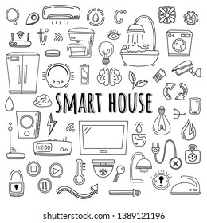
Industry Use cases
Design Tools: Tool for Engineering Drawings, Architecture Design, and Other design related tasks. It can also be used in Smart City Design
Educational Tools for Learning and Creativity: For example, Interactive Whiteboards
UI/UX Design Tools: Helps designers in making various UI/UX elements simply by drawing
Smart Home Devices: Integration with smart devices where users can draw a particular object (e.g., a lightbulb) to activate or control specific smart home features.
Img src: https://www.shutterstock.com%2Fimage-vector%2Fsmart-house-vector-set-elements-equipment

Slide 14

Industry Use cases
Visual Search Engines: Users can draw objects (like fashion items or accessories), and the tool can predict what the object is, thereby improving shopping experiences.
Game Design: Game developers can sketch assets, and with model predictions enabling faster prototyping and asset creation.
Assistance for People with Disabilities: For people with disabilities who cannot type or speak, drawing might be a more accessible way to communicate. The tool could identify drawn objects and interpret commands or messages, improving interaction with digital devices.
Img src:https://www.analyticssteps.com/blogs/how-ai-improves-accessibility-people-disabilities

Slide 15
Progress Status, Deliverables and Timeline
Progress:
We have started identifying techniques that can be useful in this project. We will explore more in the model design part and check what works best. (From the learnings from Literature Review)
Parallelly, we have started working on the user interface as well as doodling software
Deliverables:
Final Prediction Model hosted on backend and UI where user can draw. The Model will predict the object drawn on the UI by the user (The implementation will involve usage of final techniques/approaches to improve accuracy and speed of object recognition).
We will also present the analysis of the approaches that we will try and give a comparative analysis.
Timeline: We expect the model to be completed by April first week, and corresponding hosting (backend) and UI design to be ready by April second week.

Slide 16
Team Contributions
All members will be working equally and together to learn all the components of the project and help fill in the missing knowledge gaps of others. But for listing the work division as asked, here is the tentative work breakdown :-
Member Name | Roll Number | Tasks
Aryan Agarwal | 241110012 | CNN Design and Backend
Keshav Banka | 241110032 | CNN Design and Frontend
Himalaya Kaushik | 241110029 | CNN Design and Frontend
Yuvraj Raghuvanshi | 241110084 | CNN Design and Backend
Tsewang Namgail | 241110093 | CNN Design and Frontend
Tsewang Chukey | 241110092 | CNN Design and Backend

Slide 17
Thank you

